Slide 1
ADULT RESPIRATORY DISTRESS
DAN MUSE, MD

Slide 2
RESPIRATORY DISTRESS
Conditions that result in a compromise in oxygenation and ventilation.
Can result in an increase or decrease in respiratory drive.

Slide 3
OXYGENATION - VENTILATION
OXYGENATION: Providing oxygen to the cells in the body.
VENTILATION: The exchange of CO2 for oxygen.

Slide 4
CONGESTIVE HEART FAILURE CHF

Slide 5
CONGESTIVE HEART FAILURE
Results from fluid building up into the lungs through hydrostatic pressure and changes in osmotic pressure.
The pressure of the blood and plasma in the vessels traversing the lungs increases to the point where by the plasma fluid leaches out into the lungs.

Slide 6
Oncotic pressure
Oncotic pressure “pulls in”.
Large molecules such as albumin and other proteins need fluid and draw it in from the soft tissue.
A change in these pressures i.e. ”low albumin” can cause fluids to leach back out.

Slide 7
HYDROSTATIC PRESSURE
Hydrostatic pressure “pushes out”
Fluids in the vessel leach out in order to equilibrate with the lower outside pressure.

Slide 8
CONGESTIVE HEART FAILURE
CAUSES MAY INCLUDE………..
Pump failure. The heart no longer has the strength to pump effectively. Cardiomegally and low ejection fraction.
Valvular heart disease resulting in backwashing
Vascular resistance causing resistance to outflow

Slide 9
cardiomegaly

Slide 10
Valvular heart disease

Slide 11
CONGESTIVE HEART FAILURE
SYMPTOMS…
Shortness Of Breath
Pnd And Orthopnea
Peripherial Edema

Slide 12
CONGESTIVE HEART FAILURE
CLINICAL SIGNS……
Increased Respiratory Rate
Bp Can Be Low, Normal Or High
Rales, Diminished Breath Sounds, Wheezes
JVD, Peripheral Edema

Slide 13
CONGESTIVE HEART FAILURE
TREATMENT……
OXYGEN…….Increases oxygen carried in the cells
LASIX……Removes fluid from the body. This in turn reduces the hydrostatic pressure in the vessels and makes the amount of blood more manageable.
NITRITES…….Dilates the vessels so that they can accommodate the fluid.
CPAP……

Slide 14
RADIOGRAPH OF CHF ENLARGED HEART FLUID (THE WHITE) BUILD UP IN THE LUNGS

Slide 15
PULMONARY EDEMA

Slide 16
PULMONARY EDEMA
Really Bad CHF
Most Often Associated With Cardiac Ischemia
Typically Has A Sudden Onset.
Findings Early On Include Hypertension, And Rales.

Slide 17
NONCARDIOGENIC PULMONARY EDEMA

Slide 18
NONCARDIOGENIC PULMONARY EDEMA
ALSO KNOWN AS ARDS…Adult Respiratory Distress Syndrome
Distinguished from pulmonary edema by underlying cause.
Typically the heart size is normal.
Is a symptom of another problem.

Slide 19
NONCARDIOGENIC PULMONARY EDEMA
CAUSES…..
Head Injury
Infection
Drugs
Severe Trauma
Smoke Inhalation And Burns
Inflamatory Processes Such As Pancreatitis

Slide 20
NONCARDIOGENIC PULMONARY EDEMA
SYMPTOMS…..
Similar to CHF and pulmonary edema.
SOB and often sudden.

Slide 21
NONCARDIOGENIC PULMONARY EDEMA
CLINICAL FINDINGS…..
SOB with rales.
Blood pressure variable

Slide 22
NONCARDIOGENIC PULMONARY EDEMA
TREATMENT……
Supportive. Need to treat underlying cause
Diuretics typically do not work
You will give the diuretic because you can’t distinguish noncardiogenic from cardiogenic in the field.

Slide 23
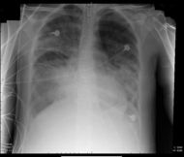
NONCARDIOGENIC PULMONARY EDEMA
CAN NOT DISTINGUISH FROM CARDIOGENIC
PULMONARY EDEMA

Slide 24
PULMONARY EDEMA

Slide 25
PULMONARY EMBOLUS PE

Slide 26
PULMONARY EMBOLUS
Caused By A Clot Lodging In A Pulmonary Vessel

Slide 27
CAUSES……….
Typically associated with recent surgery, trauma or travel.
Higher rate in women who smoke and take bcp’s.
May be first time presentation for someone with cancer or blood disorder.

Slide 28
PULMONARY EMBOLUS
SYMPTOMS
Symptoms will vary depending on the size and location of the clot.
May have pleuritic chest pain caused by lack of blood flow to the peripheral lung near the pleura.
Shortness of breath
Swollen leg if DVT is a source

Slide 29
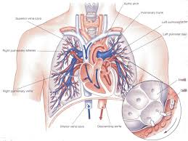

Slide 30
PULMONARY EMBOLUS
CLINICAL SIGNS……
Increased respiratory rate.
Lungs may be clear, diminished or even wheezes
Heart rate may be elevated. Most common finding is tachycardia
Leg swelling

Slide 31
PULMONARY EMBOLUS
EKG…..
Can result in finding of right sided heart strain because of the outflow blockage from the right ventricle
Most common finding is tachycardia
May have S1, Q3,T3
Can cause incomplete or complete right bundle.

Slide 32
PULMONARY EMBOLUS
TREATMENT……
Oxygen
Treatment is predicated on clinical findings.
Can vary from transporting to CPR

Slide 33
POTENTIAL FINDINGS ON EKG OF A PE
S1Q3T3
RIGHT INCOMPLETE OR COMPLETE BUNDLE

Slide 34
THROMBUS IN MAIN PULMONARY ARTERY
THE MORE PROXIMAL TO THE HEART THE MORE LETHAL

Slide 35
PNEUMOTHORAX PTX

Slide 36
PNEUMOTHORAX PTX
WHEN AIR OCCUPIES THE PLEURAL SPACE CAUSING COMPRESSION OF THE LUNG

Slide 37
PNEUMOTHORAX PTX
CAUSES………
Seen in thoracic trauma.
May be caused by penetration into the thorax or from sudden changes in pressure on the lungs
Spontaneous causes
May result from space occupying lesions in the chest

Slide 38
PNEUMOTHORAX
SYMPTOMS……
Varying degree of shortness of breath.
Splinting and/or pain on inspiration
Tachycardia
Chest wall pain if traumatic

Slide 39
PNEUMOTHORAX
CLINICAL SIGNS……
Normal to elevated respiratory rate
Normal to rapid heart rate
Normal to diminished breath sounds.
Chest wall tenderness and/or crepitus
Tracheal deviation

Slide 40
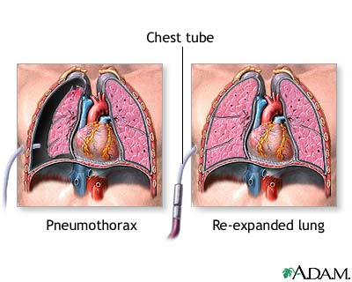
PNEUMOTHORAX

Slide 41
PNEUMOTHORAX

Slide 42
PNEUMOTHORAX CT SCAN
CAUSED BY LUNG PUNCTURE FROM CENTRAL LINE

Slide 43
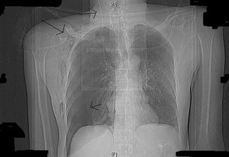
Pneumothorax caused by central line

Slide 44
TENSION PNEUMOTHORAX
CLINICAL SIGNS
Elevated respiratory and heart rate
Change in blood pressure…usually down
Very dyspneic
Tracheal deviation may be present
Crepitus may be present.
Diminished to loss of breath sounds

Slide 45
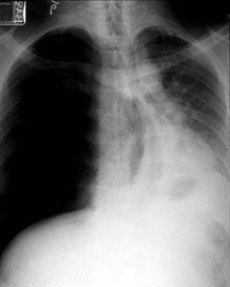
TENSION PNEUMOTHORAX
Note The Pressure Caused By The Pneumothorax Compressing Everything To The Left.

Slide 46
PNEUMOTHORAX
TREATMENT…….
Supportive measures if no respiratory compormise
If clinically the patient has a tension ptx, this is a life threatening event and the patient needs immediate intervention…NEEDLE THORACENTESIS

Slide 47
COPD

Slide 48
COPD
CHRONIC OBSTRUCTIVE PULMONARY DISEASE
Made up of emphysema, chronic bronchitis and asthma.
Results from inflammation of the bronchioles which causes narrowing.
This in turn causes difficulty for air to pass in and out.

Slide 49
COPD
CAUSES…….
Smoking
Smoking
Asbestosis
2nd Hand Smoke
Restrictive Lungs
Reactive Airway Disease
Allergic And Exercise Induced

Slide 50
COPD
SYMPTOMS…….
Increasing difficulty breathing
Oftentimes associated with upper respiratory infections
Asthmatics may have a cough equivalent

Slide 51
COPD
CLINICAL SIGNS…….
Dyspnea
May have barrel chest if emphysema or due to kyphosis
Wheezes or diminished breath sounds
Typically no extremity edema

Slide 52
COPD
TREATMENT……
Oxygen
Albuterol or duoneb.
Solumedrol
CPAP

Slide 53
CO2 RETAINERS
Normal mechanism to breath is due to increased CO2.
The secondary mechanism is hypoxia
CO2 retainers have “burned” out the CO2 mechanism and rely on hypoxia to force themselves to breath.
Giving to much oxygen will cause their body to believe they do not need to breath and the co2 builds up.

Slide 54
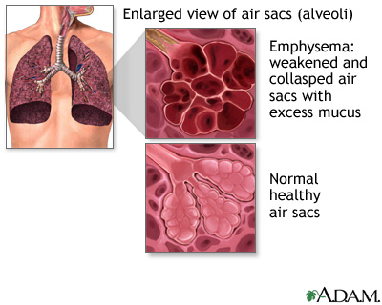
COPD
UNHEALTHY LUNG DUE TO SMOKING

Slide 55
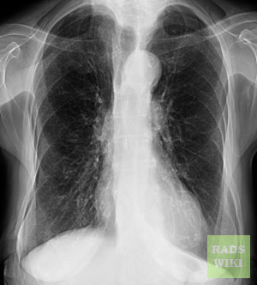
COPD
NOTE THE ELONGATED LUNGS AND DECREASED VASCULAR MARKINGS.

Slide 56
NON RESPIRATORY CAUSES OF RESPIRATORY DISTRESS

Slide 57
CARDIAC TAMPONADE
Caused by fluid building up between the heart and pericardium
Causes restriction of blood flow and therefore, deminished flow of oxygenated blood reaching the lungs.

Slide 58
CARDIAC TAMPONADE
BECK’S TRIAD: JVD, Distant Heart Sounds And Hypotension.
May see Electrical Alternans on EKG. Seen in very large effusions/tamponade and caused by the wavy motion of the fluid
Pulses paradoxes may be heard on BP.

Slide 59
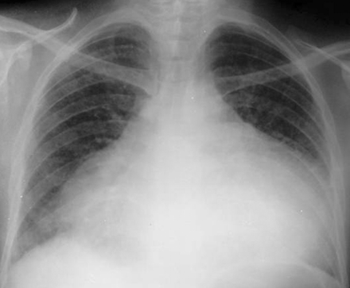
CARDIAC TAMPONADE

Slide 60
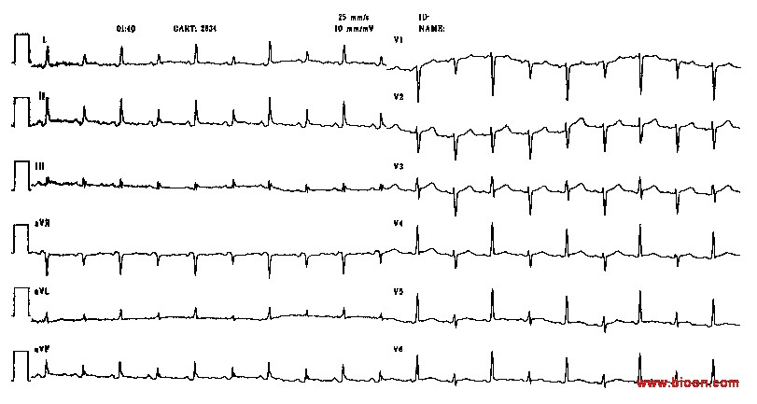
ELECTRICAL ALTERNANS
The QRS axis alternates between beats. In this example it is best seen in the chest leads where the QRS points in different directions!

Slide 61
PULSUS PARADOXUS
Some respiratory variation of pulse amplitude should be observed during examination of the arterial pulse. Systolic arterial pressure normally falls during inspiration, although the magnitude of decrease usually does not exceed 8 to 12 mmHg. A more marked inspiratory decrease in arterial pressure exceeding 20 mmHg is termed pulsus paradoxus.

Slide 62
DRUG OVERDOSE
CAN BE SEEN WITH MEDICATIONS CAUSING CNS DEPRESSION
NARCOTICS, BENZODIAZAPINES, ETOH…..
CAN RESULT IN APNEA AND DEATH

Slide 63
CNS INJURIES
CNS bleeds and tumors can result in an increased ICP with resultant diminishment in respiratory drive.
C1 and C2 FX’s will be unable to breath on their own.

Slide 64
Carbon monoxide
Byproduct of partially combusted fuel.
Is odorless and colorless
Cause of both intentional and unintentional deaths

Slide 65
Carbon monoxide
Carbon Monoxide has a stronger affinity for hemoglobin than oxygen
Given the choice, hemoglobin will bind with carbon monoxide.

Slide 66
Carbon monoxide
This results diminished oxygen delivery
Depending on the effect, it may impact the body with
Headaches
Nausea and vomiting
AMS
Death

Slide 67
Carbon monoxide
Pulse Oximetry tends to be normal since it measures the percentage of hemoglobin that is saturated and not what saturates it.

Slide 68
Carbon monoxide
Treatment is high flow oxygen at 100% in order to push the carbon monoxide off the hemoglobin

Slide 69
CPAP
Allows for continuous pressure which keeps the lungs “open”.
Breathing is made easier since the air is pushed into the lungs.
This allows the patient to rest the intercostal muscles.

Slide 70
CPAP
CPAP is a temporary adjunct that will assist the patient in breathing while the underlying respiratory distress is being reversed.

Slide 71
CPAP
When to apply CPAP is a clinical decision.
You do not want to wait till the patient is in extreme respiratory distress, or is to somnolent to tolerate it.

